Slide 1
Introduction to cubesat development

Slide 2
Outline (Part A)
The cubesat concept – timeline and statistics
The on board computer (OBC)
  The OBC missions
  The microcontroller unit (MCU)
  The PC104 standard
The satellite software
  The satellite state machine
  The operating system
  Software layers

Slide 3
Part 1: The cubesat concept

Slide 4
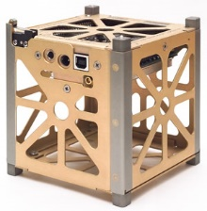
The cubesat standard
“ The purpose of the project is to provide a standard for design of picosatellites to reduce cost and development time, increase accessibility to space, and sustain frequent launches”
From the cubesat design specification document: http://www.cubesat.org/resources/
Notes:
First: define standard
Second: Accessibility,

Slide 5
The cubesat concept – timeline
Introduced by groups in Caltech and Stanford
Turning point in cubesat commercial use
Exponential growth of cubesat launches, research and development
1999
2003
2013
2017
First cubesat successful launch
Constellations:
QB50 scientific
flock 2k –commercial
Notes:
First intended for educational reasons for students, same capabitlites of the sputnik
Up to 2013 most cubesats were used for academic purposes

Slide 6
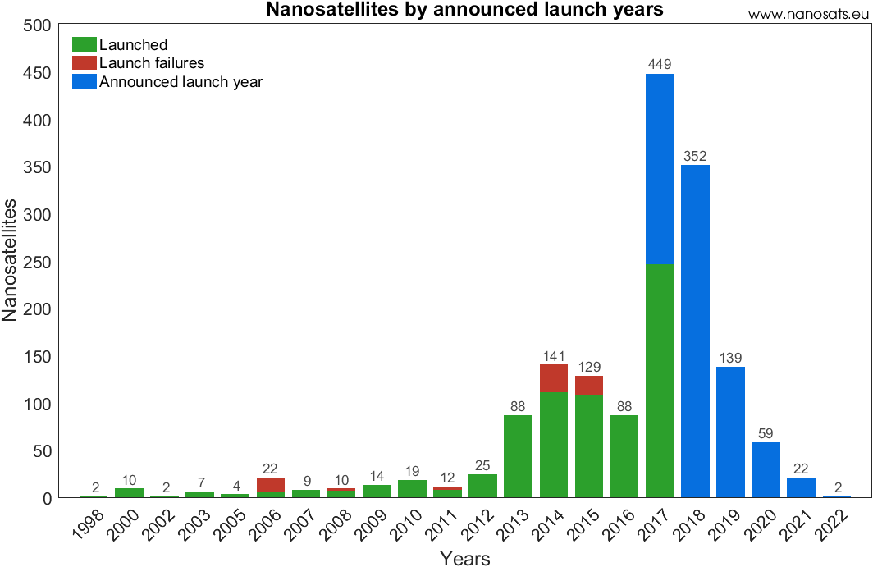
Launches per year
Taken from the cubesat & nanosats database: www.nanosats.eu
Notes:
Nanosatellites – up to 10kg
2.

Slide 7
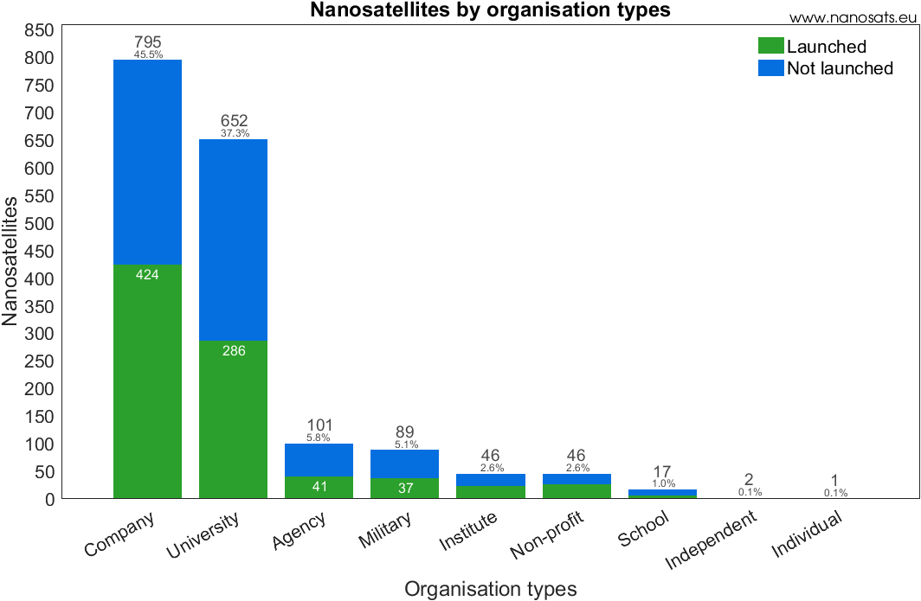
Launches per organizations
Taken from the cubesat & nanosats database: www.nanosats.eu

Slide 8
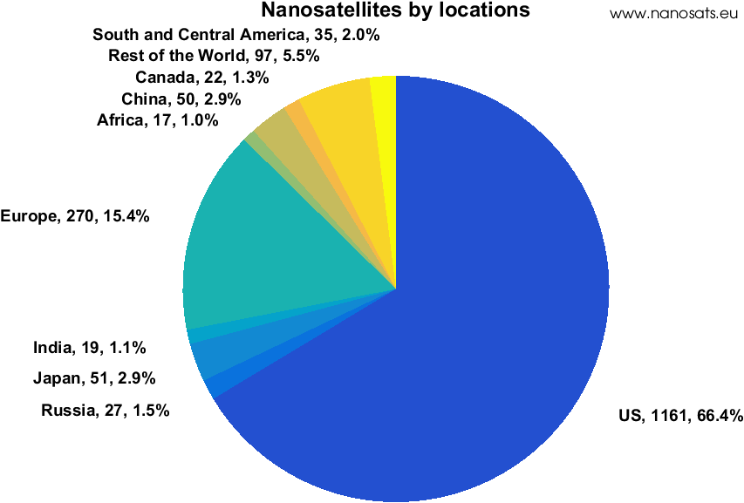
Launches per country
Taken from the cubesat & nanosats database: www.nanosats.eu
Taken from the cubesat & nanosats database: www.nanosats.eu
Notes:
Wikipedia – first satellites for many countries, mention UNOOSA

Slide 9
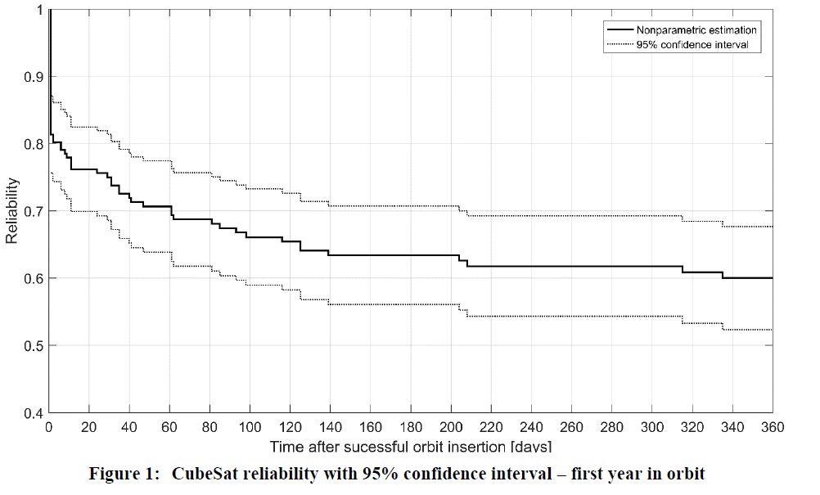
The cubesat failure rate
Taken from Langer & Boumeester (2016) “Reliability of cubesats, statistical data, developers’ belief and the way forward”

Slide 10
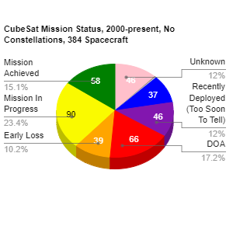
The cubesat failure rate
Taken from https://sites.google.com/a/slu.edu/swartwout/

Slide 11
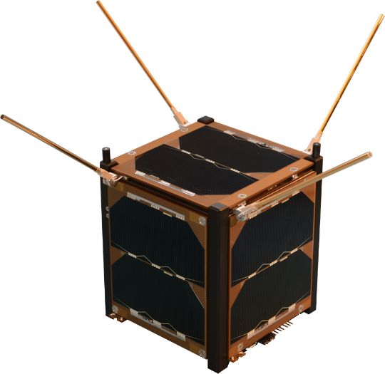
The cubesat concept – main lessons
Make the design Simple and then simplify
Avoid non standard HW as much as possible
Use only parts with flight heritage
Stay focused on mission!
Test and retest.

Slide 12
Part 2: the on board computer

Slide 13
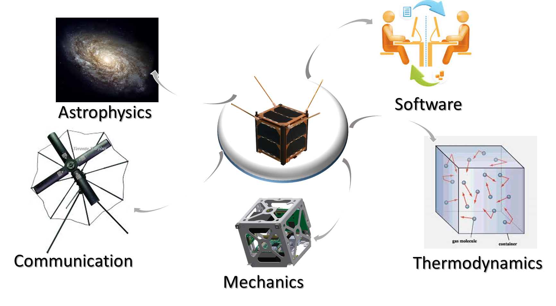
Areas of interest – cubesat R&D
Notes:
Cubesat – multidisciplinary project

Slide 14
OBC software missions
Payload
Attitude determination and control
Manage activation of payload
Retrieve data from payload
Electric power system
Receive estimates of attitude and angular rates
Switch between ADCS modes when necessary
Retrieve ADCS parameters
Payload
Control loop over battery voltage.
Check temperature and currents in range.
EPS
ADCS
3
Communication systems
2
4
OBC
Antennas
COM
Receive commands from GS
Build packets and Send data from SAT to GS
Antennas
Deploy antennas.
1
5

Slide 15
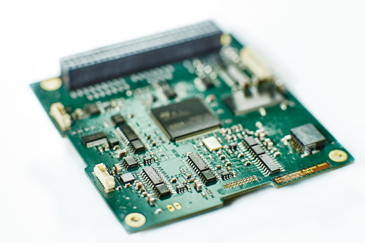
Additional missions
Run main state machine of satellite.
Manage memory
Configure inter-satellite communication
Update software
Etc.

Slide 16
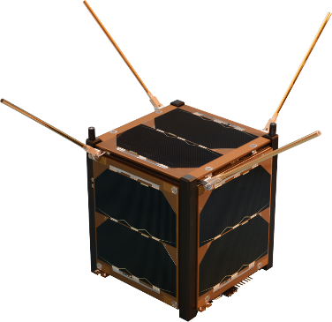
Divide and conquer
1. Main logic
5. Payload
2. EPS
. 4. ADCS
3. Communication

Slide 17
OBC - the micro-controller unit (MCU)
Definition: A microcontroller is a single chip containing at least a CPU, non-volatile memory, volatile memory, a timer and an I/O control unit.
Notes:
Basically a computer on chip
Volatile memory is computer memory that requires an active power connection to function

Slide 18
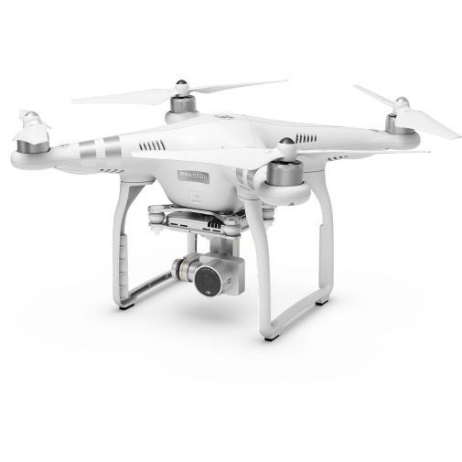
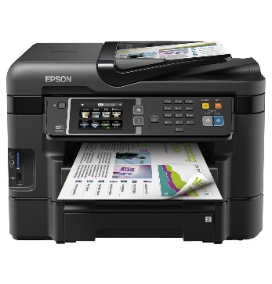
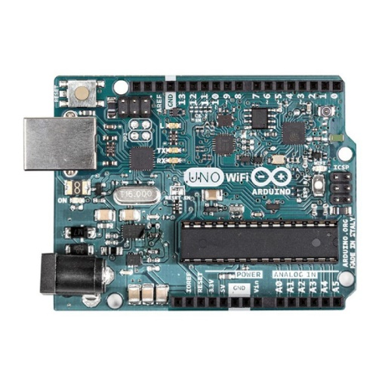
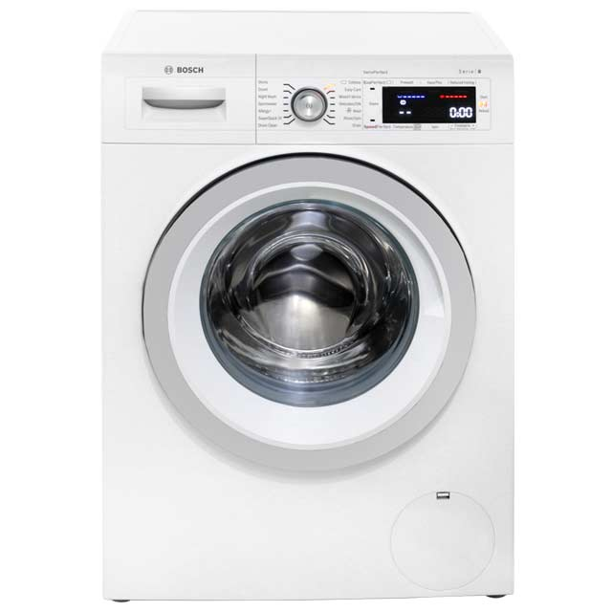
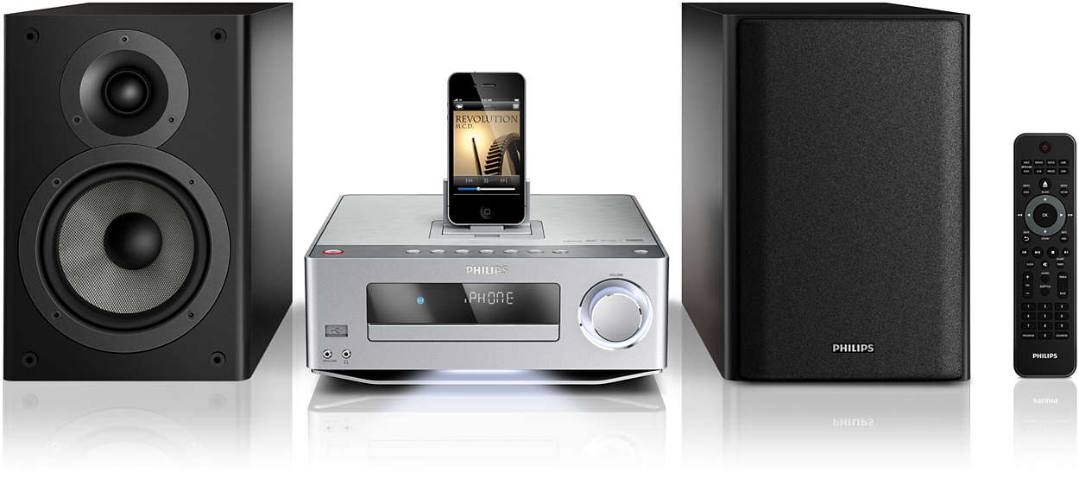
MCUs are everywhere!!
An Arduino MCU
Notes:
Statistics: Around 60 MCU’s in a regular household

Slide 19
Advantages of MCU
Low power consumption.
Powerful and carefully chosen electronics systems – resulting in low prices.
Prior knowledge is hardly needed for programming.
Notes:
All these make it a perfect match for nanosatellites!!

Slide 20
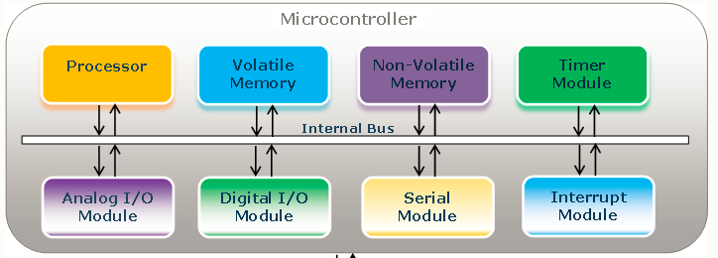
The MCU structure

Slide 21
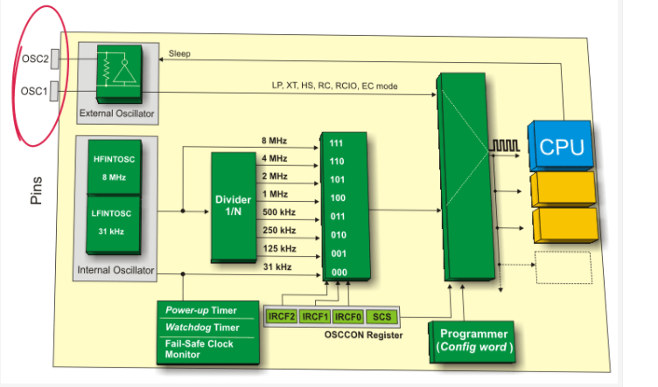
The MCU timing module

Slide 22
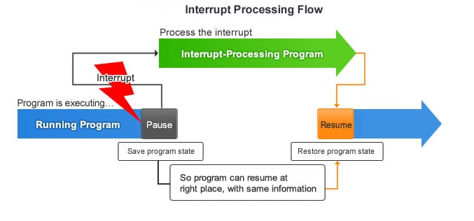
The MCU interrupt module
Notes:
First explain what is the idea behind interrupts, why does it adher to MCU power.

Slide 23
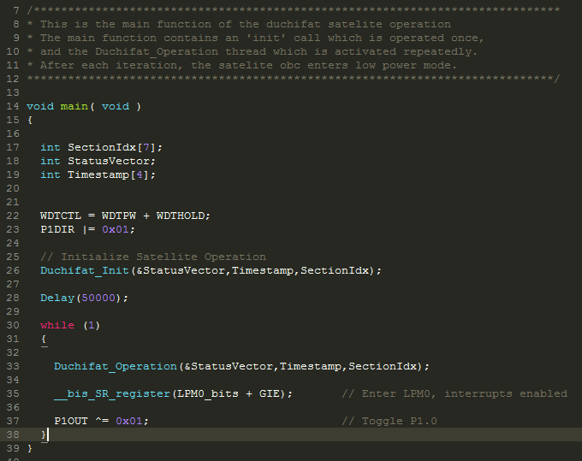
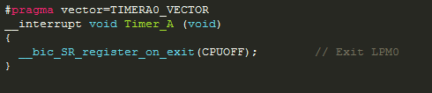
Interrupt code example – Duchifat 1

Slide 24
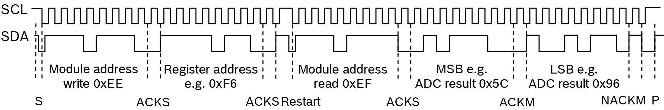
The MCU I2C communication module
OBC (master)
EPS (slave)
COM (slave)
Clock
Data

Slide 25
I2C read/write functions
void I2C_write(int length, int sa ,char *srcadr)
void I2C_read(int length, int sa , char *dstadr)

Slide 26
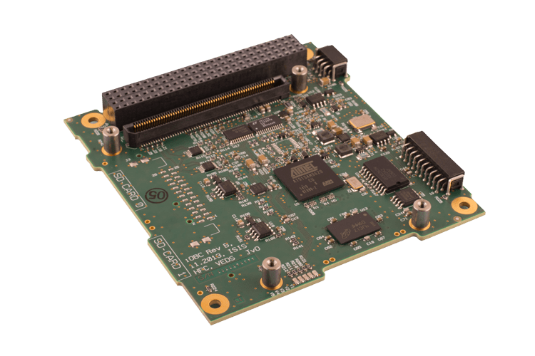
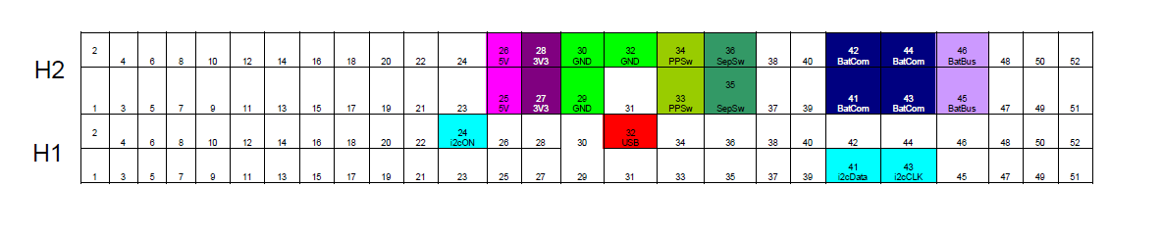
Back to OBC – Cubesat PC104 standard
Taken from the Clyde space EPS user manual (used in Duchifat 1)

Slide 27
Part 3: The cubesat software components

Slide 28
Cubesat software layers
Satellite main logic and tasks
Drivers for cubesat components
Operating system
Low level MCU (HAL)

Slide 29
Examples for low level MCU functions
void I2C_write(int length, int sa ,char *srcadr)
void I2C_read(int length, int sa , char *dstadr)
void init_timer();

Slide 30
Operating system
Definition: An operating system (OS) is a collection of software that manages computer hardware resources and provides common services for computer programs.

Slide 31
Operating system
Important functions: memory management, processor management, security etc.
Advantages for cubesats:
Allows for better modularity between the different cubesat assignments. Each assignment is run as a separate thread.
Better failure tolerance.
Notes:
Additional advantages, separation between different projects

Slide 32
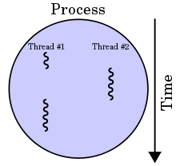
Definition of SW thread
A thread is a path of execution through the program.
Notes:
Example of book reading

Slide 33
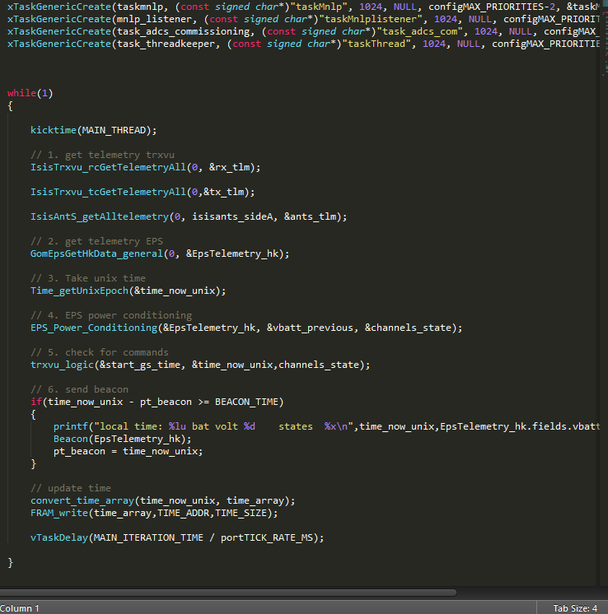
OS – code example (Duchifat 2)
Notes:
Add second example of dump thread

Slide 34
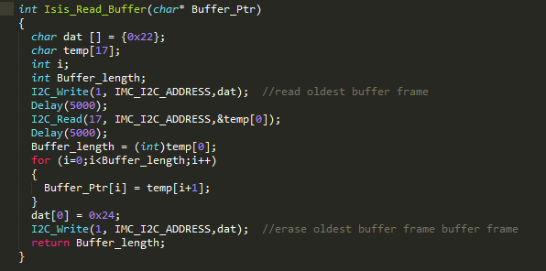
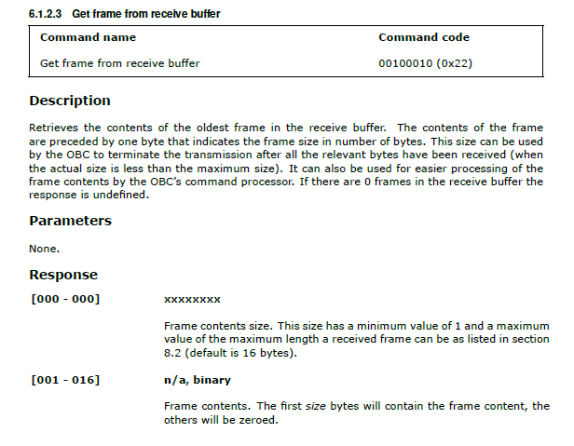
Driver example
From the ISIS TRXUV user manual

Slide 35
Main logic - the cubesat state machine

